Slide 1

India Latin America Associates
Partners in Progress
Business Growth Catalyst…

Slide 2
Our Company
Established in -----------, India Latin America Associate (i-LATAM) as a Global partner to propagate, promote and popularize the cross cultural, commercial and economic development of the two region.
Our skills encompasses a complete range of advisory and assurance services in the areas of -----------------------
A well managed organization supported by experienced dedicated diplomat, bureaucrat, academician, historian and professionals.

Slide 3
Objectives
Development of institutional framework for economic, commercial and social interaction between India and Latin American countries
India-Latin America Associates (IndiaLATAM) is a premium business Consultancy organisation providing business advisory and assurance support to India and Latin America’s business and social organisations particularly to Pacific Alliance, a Latin American Trade Bloc, comprising Chile, Mexico, Peru and Columbia.
The aim of the IndiaLatam is:
To help enhance further trade ties, identify common markets for business expansion;
To facilitate deeper trade and strengthen commercial ties between the India and Latin America;
To help build people to people contact and develop networks.

Slide 4
Our Group
Our Vision
“To become a preferred choice of catalyst to customers for their organizational objectives of profitable and sustainable growth”
Our Mission
“To develop in-house capability to offer specific, unique and tailor made solutions to customers for the niche areas”
An inspiring example !

Slide 5
Our Quality Policy
“We strive towards excellence in all endeavour to act as a knowledge partner to our customer to help them achieve profitable and sustainable growth through an interactive and collaborative manner”
…strive beyond excellence!

Slide 6
Our Services
Public policy and governance;
Technology transfer, absorption and development;
Corporate finance, strategy, Performance improvements, Human resources, M&A;
Training & development;
Cultural Linkages
Netwroking

Slide 7
Organisation
President
Effective: 1st January 2015
Public Policy
& Governance
Technology
Corporate strategy
Cultural Linkages
To be developed further
Talent Acquisition
Compensation & benefits
Performance appraisal
Training & development
Capital market
Finance & performance analysis
M&A
Transactions
Growth drivers
Marketing strategy
Operational strategies
Organisation
Media advisory
Process improvements
Lean sigma
Management systems
Productivity solutions
Benchmarking

Slide 8
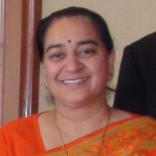
Profile of our President
Kavita Kapur is a PhD in Organizational Behaviour from Management Development Institute (MDI), India. She has been teaching management courses at the Adolfo Ibanez School of Management, Chile; Pannashastra University, Cambodia; and Kathmandu University, Nepal.
An HR professional with more than 20 years of experience, Kavita has worked as an HR Manager in multi-national corporations and as a Management Trainer and Change Management Consultant in HR, Organizational Development and Total Quality Management in management consultancy organizations.
She is deeply committed to development, learning and research in the field of Human Resources Management.
Teaching university level courses in various countries along with research in the area of multicultural teams and diversity has further strengthened her knowledge and understanding of working in different cultures.
Also, the varied experience of being a practitioner, consultant, trainer and researcher has given her a unique blend of skills and competencies as a professional in Organizational Behavior.
Her current research interests are in the area of geographically dispersed multicultural teams, team diversity, cross cultural management, and expatriate adjustment.
Besides she has wide range of practical experience and skills with a global perspective, having lived and worked in various countries (France, Nepal, Cambodia, India and Chile).
As spouse of an Indian diplomat, she was actively involved in organizing various social, cultural and National Day events in host countries and has worked closely with the Indian expatriate community.
She was the founder and Patron of the Indian Social Network, an association of Indian expats in Chile and was the President of the Diplomatic Spouses Association in Chile, organizing various fund raising and social welfare events and activities. She was awarded for “Empowerment of Women, 2013” for her social and professional work in Chile by Mujer Opina, an NGO.
Dr. Kavita Kapur
Indian National Born on:
15th October, 1963
Qualification:
Ph.D in Organisational Behaviour from MDI, Gurgaon
Experience:
Visiting at Universidad Adolfo Ibañez
Silver Spring, MarylandHuman Resources

Slide 9
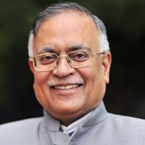
Profile of our MD
Ambassador Pradeep Kumar Kapur joined the Indian Foreign Service (IFS) in the year 1979 and he attained the rank of Secretary, Ministry of External Affairs, Government of India in 2013.
He was first in his batch to serve as India’s Ambassador to the Kingdom of Cambodia and the Republic of Chile.
He was the Founder President, International Conference on ‘Connecting World Heritage Sites and Civilizations’.
He is currently Visiting Clinical Professor, International Trade, Development and Security Issues at the School of Public Policy, University of Maryland in the Washington DC Metro Area.
Bachelor of Technology (B.Tech) degree in Electrical Engineering in 1977 from IIT (Indian Institute of Technology) Delhi and Master of Technology (M.Tech) in Management and Systems (1979), a degree equivalent to MBA from IIT, Kanpur. In both undergraduate and post graduate stage, he obtained A grade with distinction.
Carried out pioneering researches on “Technology Transfer, Public Policy and Development Diplomacy” and followed the courses of Nobel Laureate Professor Amartya Sen in the year 1985 at Oxford University.
Selected as UN Fellow with Third World Diplomat Award under which he taught in Georgetown University, Washington D.C. He was the first Indian diplomat to obtain this award in 1991.
Throughout his career, he has excelled in establishing new institutions, or revitalising old organisations, and achieves the objectives, even with limited resources.
He led one of the biggest groups on the challenging trek of Kailash Mansarovar in the Himalayas.
He also holds an Advanced Diploma in French from Jawaharlal University, New Delhi, and has done a superior level course in Arts and Literature in Spanish from Complutense University, Madrid, Spain.
He is fluent in English, French, Spanish and some Indian languages.
Ambassador Pradeep Kumar Kapur, IFS
Indian National Born on:
1st January, 1954
Qualification:
B.E.(Mech), M.Tech.,
Experience:
IFS, Former Ambassador and Secretary Govt. of India.. Currently Visiting Clinical Professor, International Trade, Development and Security Issues at the School of Public Policy, University of Maryland in the Washington DC Metro Area.

Slide 10
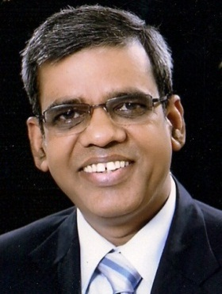
Profile of our Director
Worked as Technical Consultant to Tariff Commission ( erstwhile BICP), Govt. of India in energy audit;
Worked as Asst. Director, National Productivity Council, Kanpur and carried out consultancy assignments, conducted training programs and organised seminars etc.
Most of his professional carrier, CP worked in Alstom, a French multinational corporate in various capacity viz.
Operations Director of Transformer unit;
Business Devt. & Marketing of Industrial Projects Division;
Business Improvement & Six Sigma Champion at Alstom Power;
Unit Managing Director of Distribution Transformer Business Unit;
Regional Vice President- Service for Alstom Grid;
Developed Voltamp Energy, an Omani Company as a fast track, successful and sustainable model for MENA Region;
Currently providing leadership to DCS Group having presence in Infrastructure, Consulting & Hospitality.
Member of many national & international bodies on business excellence and performance improvement.
Widely travelled to America, Europe, Asia-Pacific, Russia and Middle-East.
C.P.Srivastava
Indian National Born on:
15th July, 1962
Qualification:
B.E.(Mech), PGDIE
Experience:
28 years of professional experience of working in Govt., autonomous institutions, NGO and multinational energy corporation in India and abroad

Slide 11
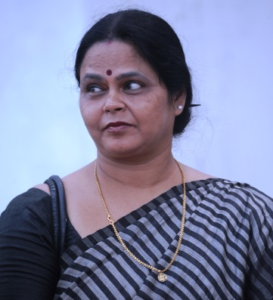
Profile of our Director
Worked with M/s Kotcher & Associates and M/s Arun Lal, Lucknow as an Asst. Architect
Worked as an Asst. Architect with UP Rajkiya Nirman Nigam at Lucknow, Allahabad and New Delhi;
Worked as an Architect with Greater Noida Development Authority on deputation.
As a Proprietor of “Design Consortium” worked on several prestigious projects in housing, educational institutions, industrial and residences as a practicing architect.
Director of DCS Infrastructure Pvt. Ltd. for last 13 years.
Empanelled with several central and state level government organisations as an architect.
Promoter of Nirkaam Foundation.
Ar. Deepali Srivastava
Indian National Born on:
24th July, 1963
Qualification:
B.Arch.
Experience:
25 years of professional experience in all aspects of architectural design, engineering and project management

Slide 12
Our Contact
Operating Company | India Latin America Associates
Address | USA: 3110, Beckenham Court, Silver Spring, MD 20906, United States Tel: +1 (301) 405-6355 Mob:+1 (301) 395 5352 | India: A-154, Sector 19, Noida-201 301, (U.P.), India Tel: +91-120-254 2154 Mob: +91 98 108 29128
Contact Person | Dr. Kavita Kapur | C.P.Srivastava
E-mail | pk.kapur@gmail.com | cppassion@yahoo.co.in
Website | www.latam.com

Slide 13

India Latin America Associates
www.latam.com

